Slide 1


TCSS573 IoT
Final Project
Group 9
Jeffrey Stockman
Viktoriya Grishkina

Slide 2
OVERVIEW
OBJECTIVE
To promote the automated capture of data and analytics around bird ecology – migratory patterns, population numbers, & environmental conditions
Reference: Audubon Society – Great Backyard Bird Count (https://www.birdcount.org/)
TARGET AUDIENCE
Bird Enthusiasts
Ornithologists
MAIN FEATURES
Environmental Sensors
Motion Detection & Vision System
Dashboard / Analysis / Webcam / Static Website
Ecologists
Biologists

Slide 3
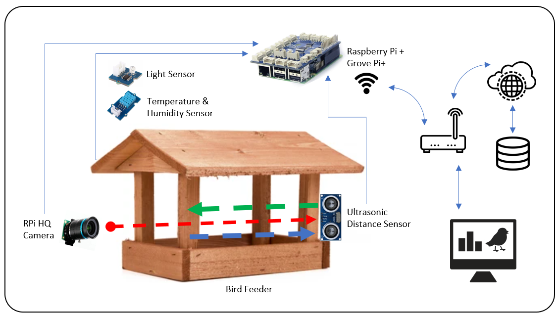
ARCHITECTURE & DEPLOYMENT
HARDWARE
Raspberry Pi 3 Model B
Grove Pi + Board
Temp/RH Sensor
Light Sensor
Ultrasonic Distance Sensor
Raspberry Pi HQ Camera
Software
Raspbian OS
Node Red
InfluxDB
Grafana Visualization

Slide 4





SERVICES
EDGE SERVICES
CLOUD SERVICES
Web browser-based development tool for IoT
Flow editor linking sensors, services, and APIs
Time series-based database
Stores sensor data and bird information
Visualization dashboard
Shares information from InfluxDB, AWS
S3: Image Storage
Image Archive
Static Website
Grafana Dashboard
Custom Vision
Bird Identification

Slide 5
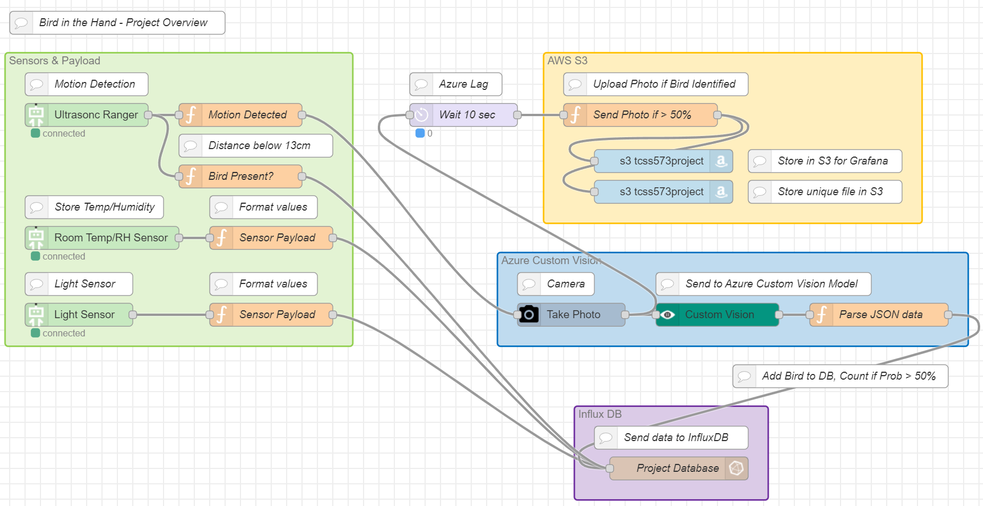
NODE-RED Flow

Slide 6
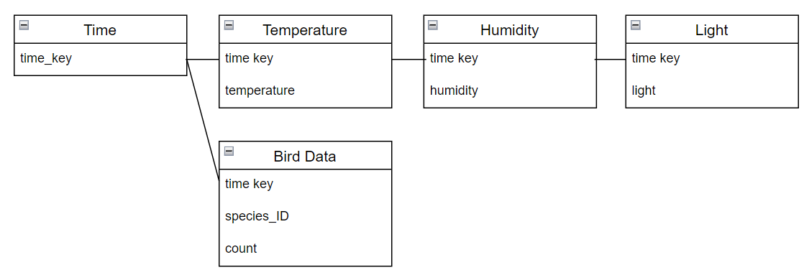
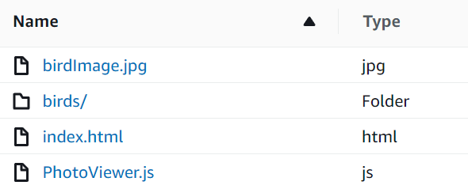
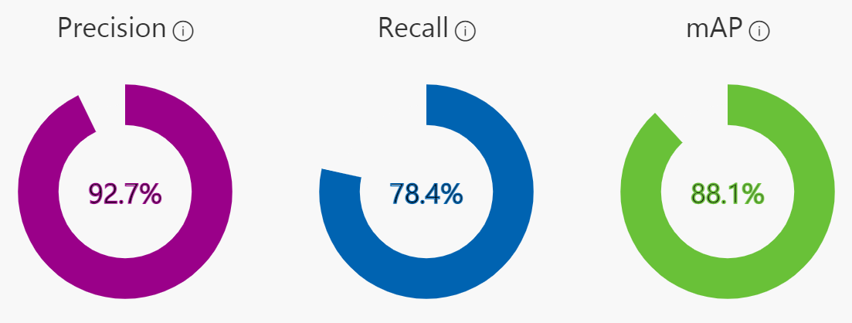
DATABASE DESIGN
AWS S3 bucket
Azure Custom Vision

Slide 7
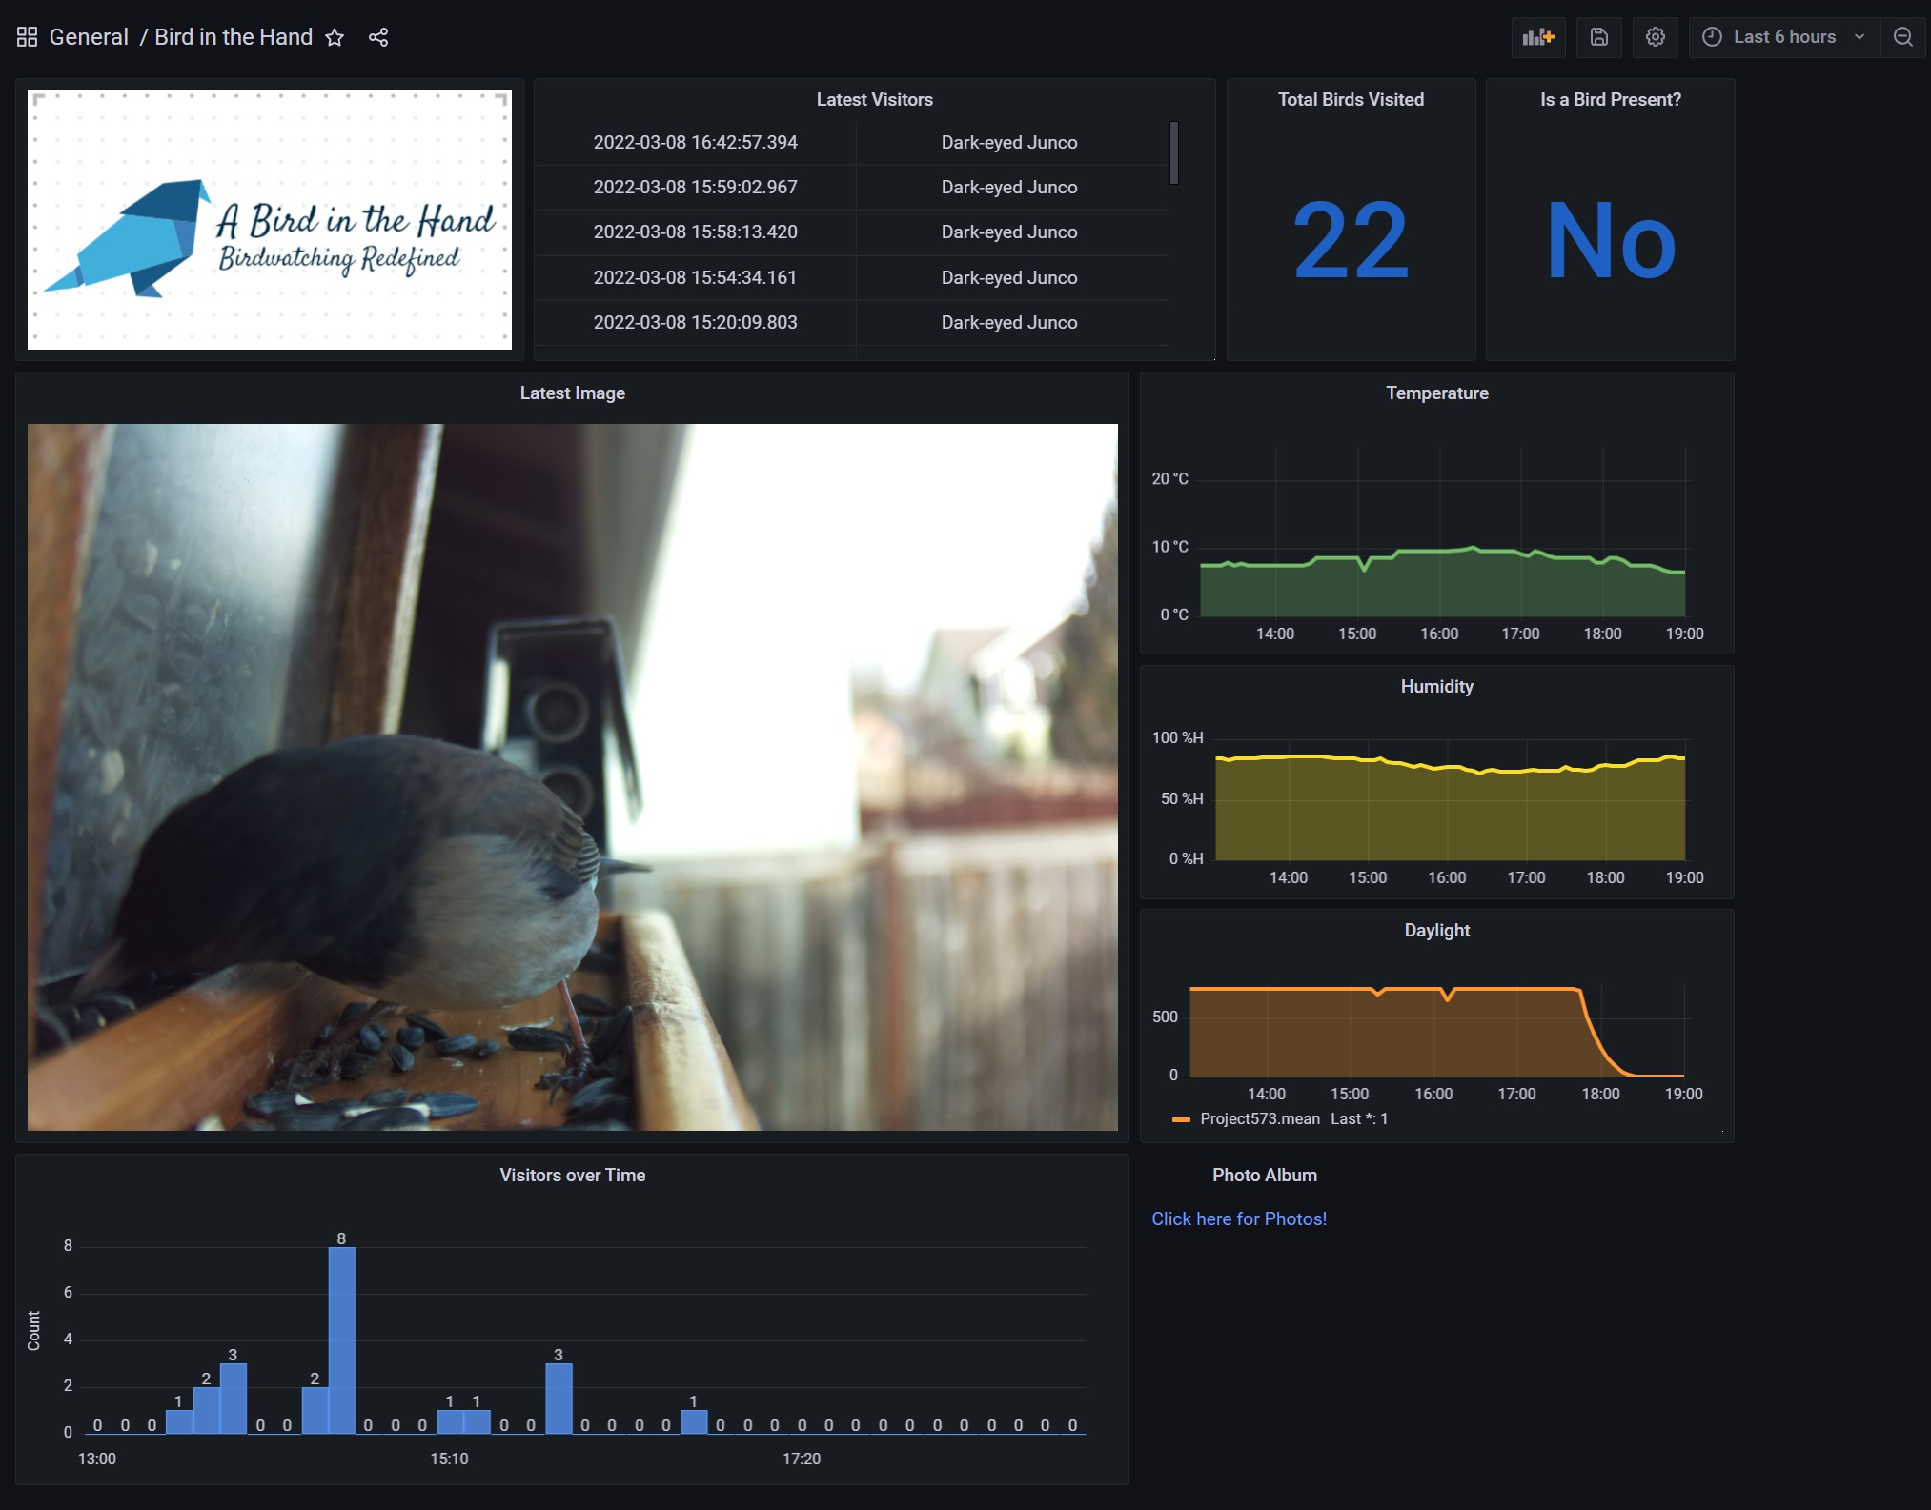
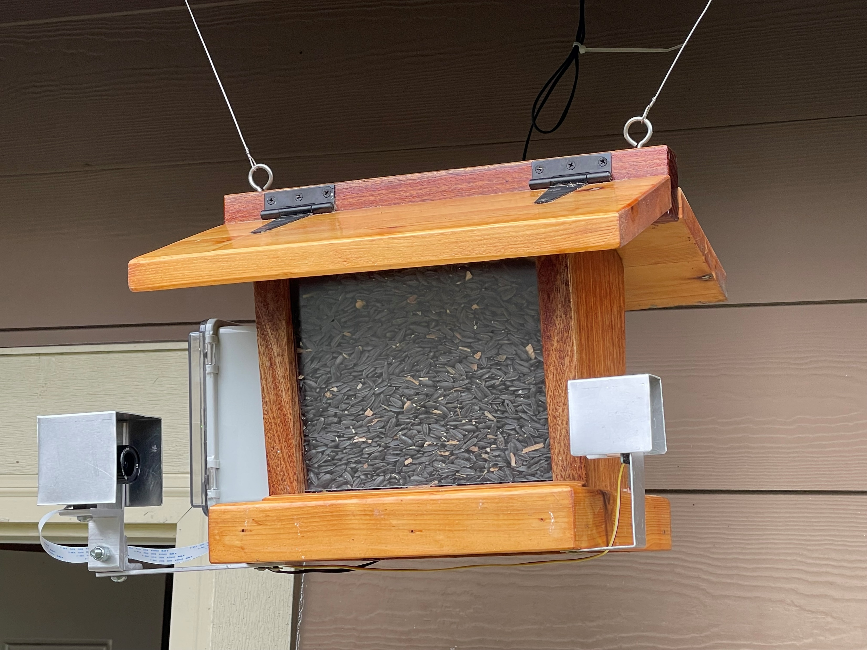
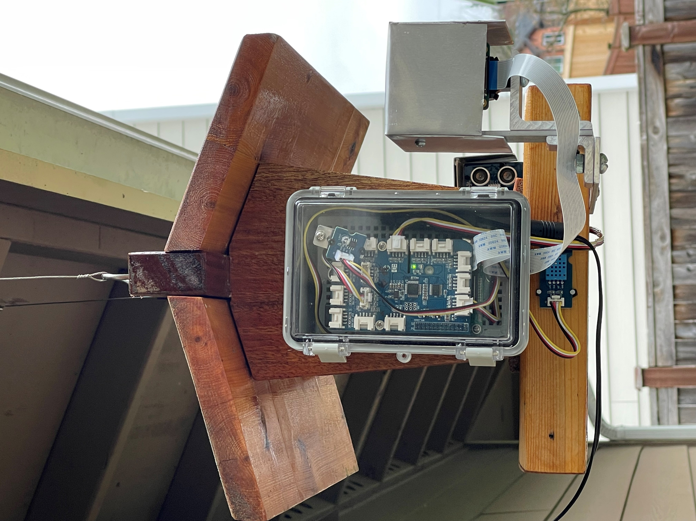
Prototype / DEMO

Slide 8
CHALLENGES
Sensor Variability
Readings influenced by outdoor environment
Drift
InfluxDB
Limited Grafana Visualization options
Camera
Unable to have simultaneous image capture + webcam feed
No auto-focus
Azure Custom Vision
Free Tier Limitations (predictions, quantity of transactions)
FUTURE ENHANCEMENTS
SQL Database implementation
Improved Grafana Visualizations & Analysis
Remove unreliable sensors (Ultrasonic)
Live Video Capture & Recording

